Slide 1

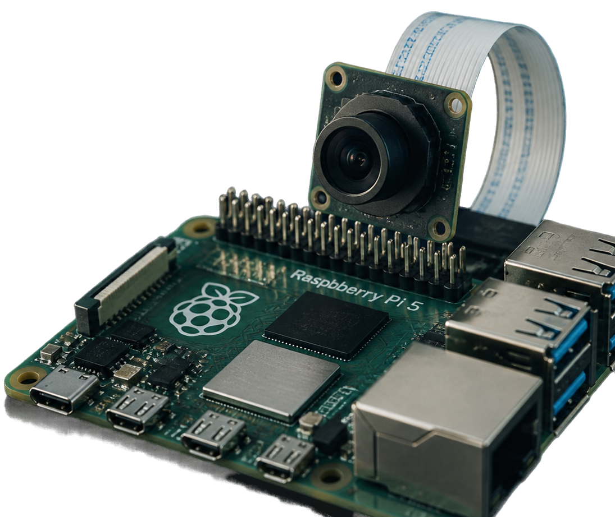
Smart Camera Monitoring System – Raspberry Pi 5 Prototype

Slide 2


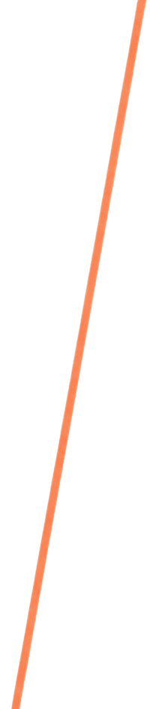
Project Background
and Prototype Objective
Manual monitoring in dusty rice
storage barns is inefficient
Motion-triggered image capture
reduces unnecessary storage
Prototype objective:
detect motion using Raspberry Pi 5 and capture and save images
only on motion events

Slide 3

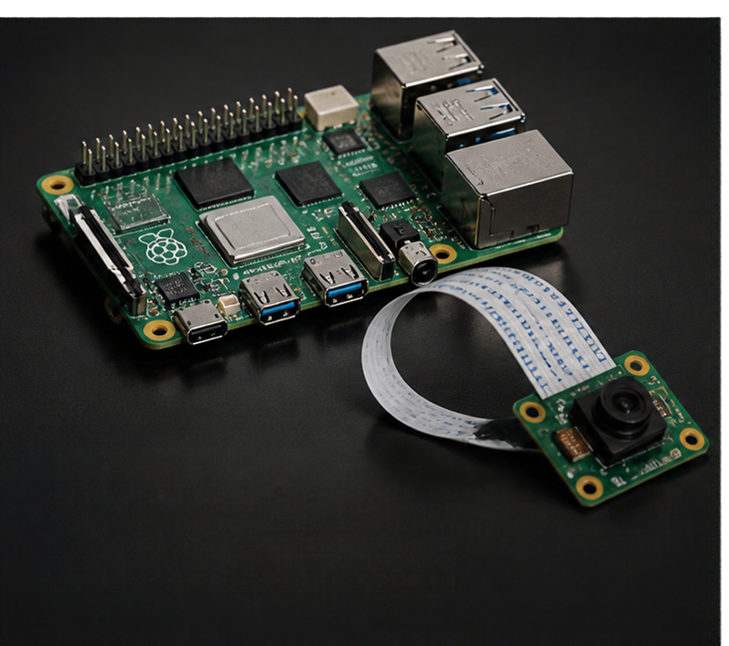
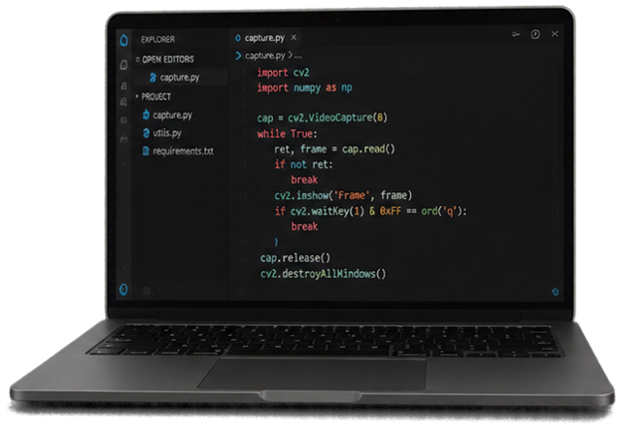
Hardware vs
Development Environment
Development Environment
Windows 11 PC
Python 3.14.10
OpenCV 5.0.0
NumPy 2.5.4
Visual Studio Code
Target Hardware
Note:
Raspberry Pi 5
compatible camera module
no physical Raspberry Pi or camera testing yet

Slide 4

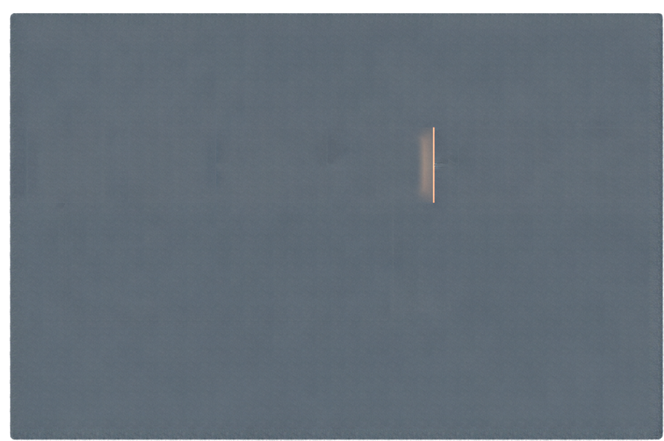
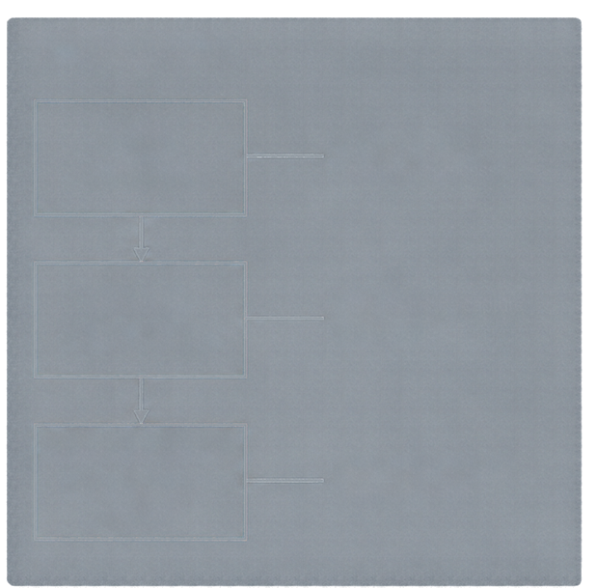
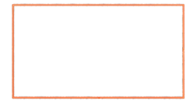
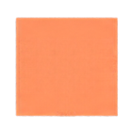
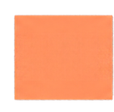
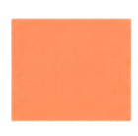
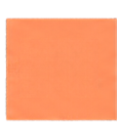
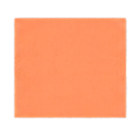
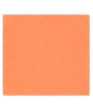

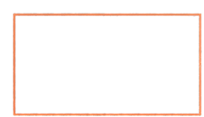

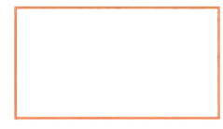
System and Software Architecture
SYSTEM ARCHITECTURE
SOFTWARE MODULES
main.py
orchestrates the monitoring process
monitoring flow
Camera
Input
Frame Acquisition
Motion Detection
Event
Decision
Image
Capture
Storage
camera.py
handles image capture and storage
capture & storage
No
motion
motionDetection.py
detects motion using frame difference
frame difference algorithm

Slide 5
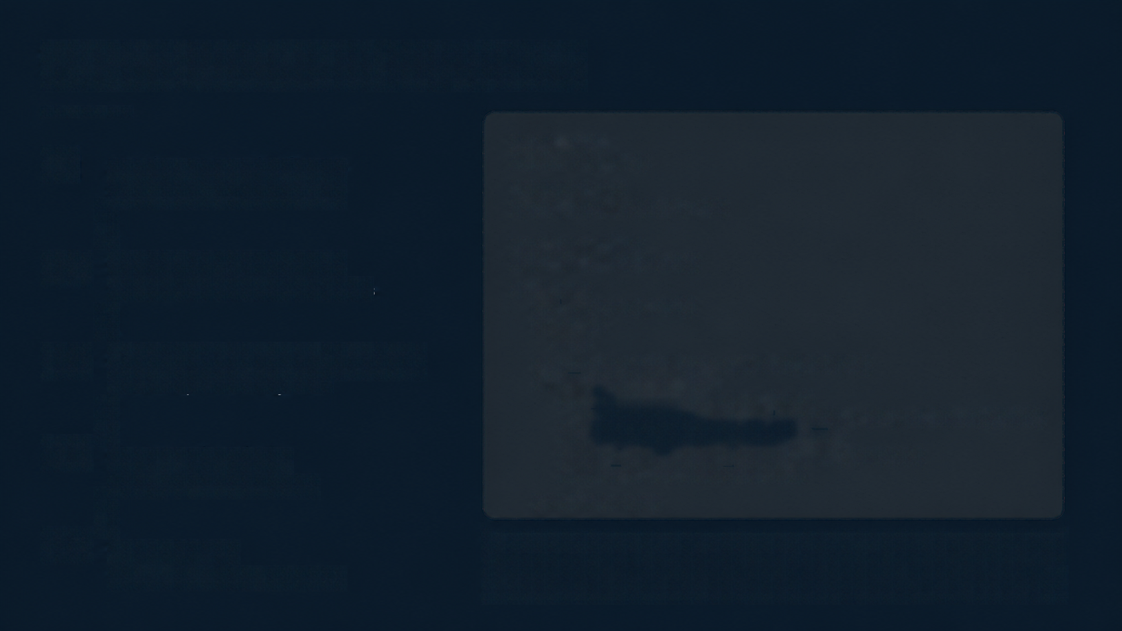





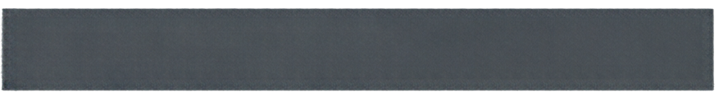
Motion Detection Algorithm
01
import cvs2
import numpy as np
Acquire consecutive frames
Read current and previous frame
THRESHOLD = 30
MOTIONCount ThRESHOLD = 500
02
prev_frame = None
cap = cv2.VideoCapture(0)
Compute frame difference
Absolute difference between frames
while True:
ret, frame = cap.read()
if not ret:
break
03
Convert to grayscale and threshold
gray = cv2.cvtColor(frame, cv2.COLOR_BGR2GRAY)
if prev_frame is not None:
diff = cv2.absdiff(gray, prev_frame)
_thresh = cv2.countNonZero(thresh)
motion_count = cv2.countNonZero(thresh)
motion = motion_count > MOTIONCount ThRESHOLD
# motion is True when count > 500
Threshold pixel intensity at 30
04
Count motion pixels
Total pixels above threshold
prev_frame = gray
05
Decide motion
Threshold values of 30 and 500 are initial prototype settings for tuning.
Motion detected if count > 500

Slide 6




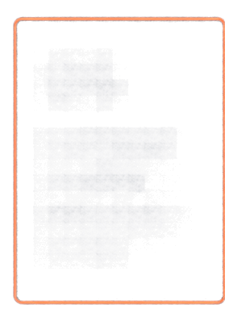





Event-Based
Image Capture Logic
From motion detection to saved image
01
02
03
04
05
Detect new motion event
Increment counter
Generate
capture
request
Save image with timestamp including microseconds
Store image
to reduce unnecessary storage
Reset
motion-active state when motion stops

Slide 7
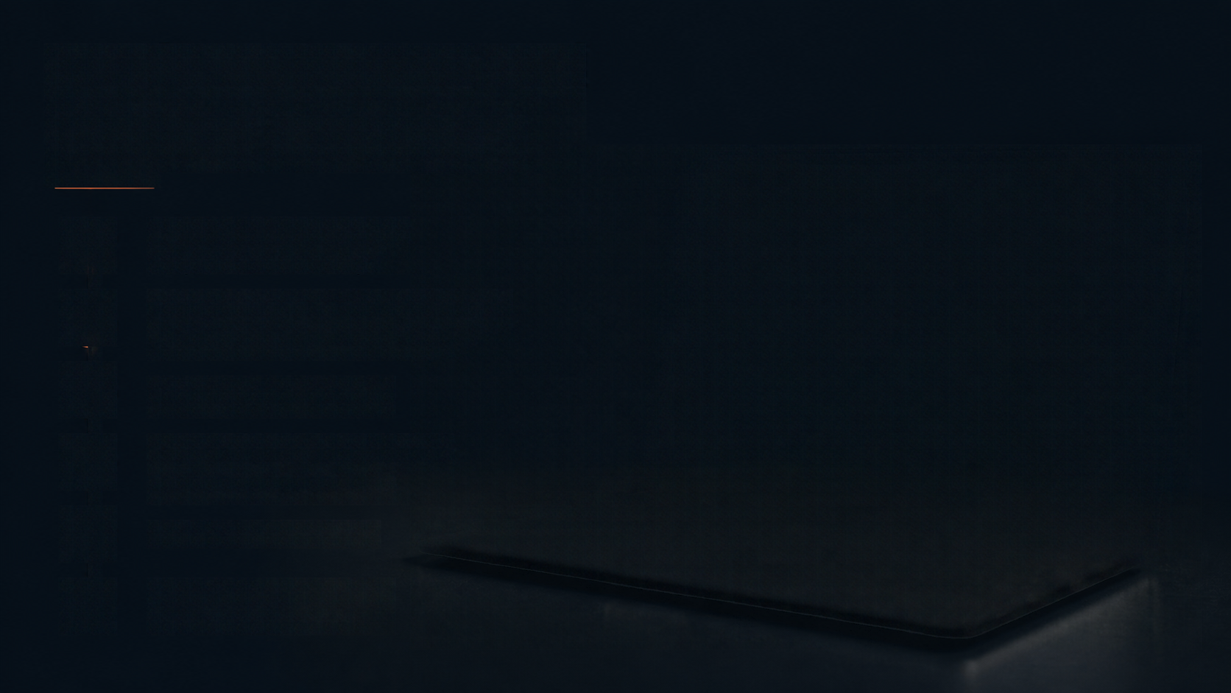
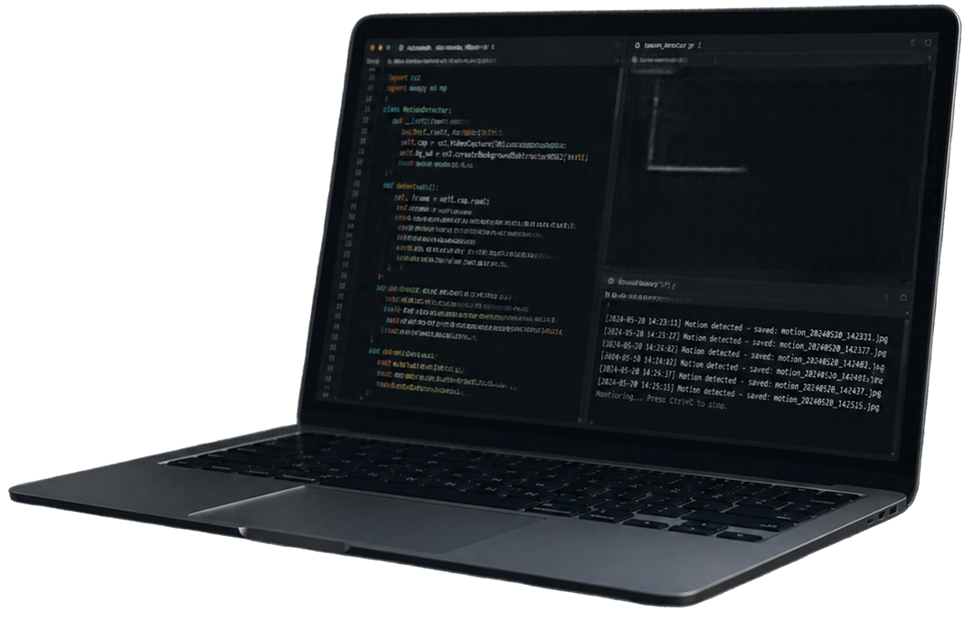
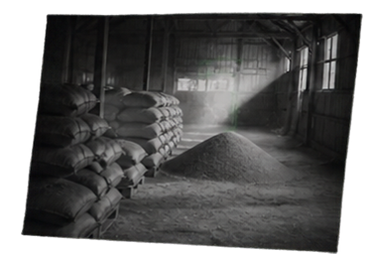






Implementation and Testing Summary
01
Python environment and dependencies setup
02
Development of motion detection and image capture modules
03
Integration of modules
04
Single-event and multi-event motion detection tests
05
Filename collision fix
06
GitHub documentation and version control

Slide 8


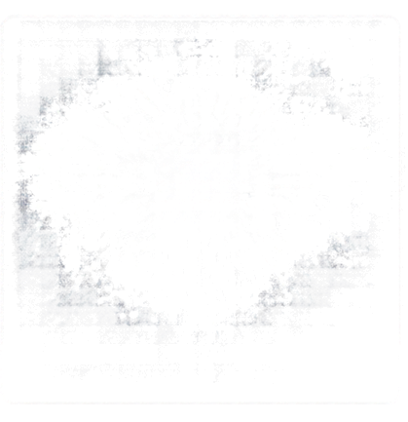
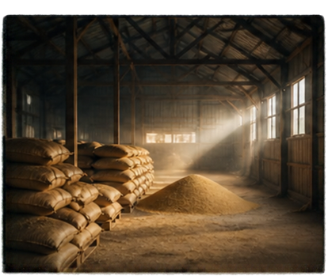

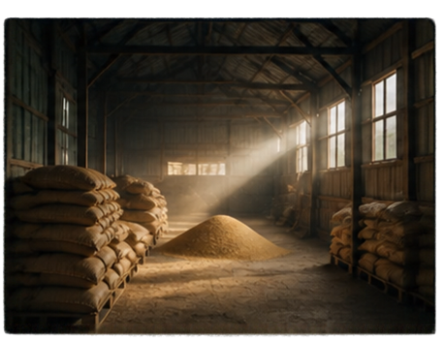
Verified Two-Event Test Results
[12:00:00] Monitoring simulation started
[12:00:18] Motion Event 1 detected
[12:00:19] Image saved: event_1_120018.jpg
[12:01:07] Motion Event 2 detected
Monitoring simulation started successfully
[12:01:08] Image saved: event_2_120107.jpg
[12:01:08] Total motion events: 2
Motion Event 1 detected; first image saved
Motion Event 2 detected; second image saved
Total motion events:
two JPG images
generated
2
event_1_120018.jpg
event_2_120107.jpg

Slide 9

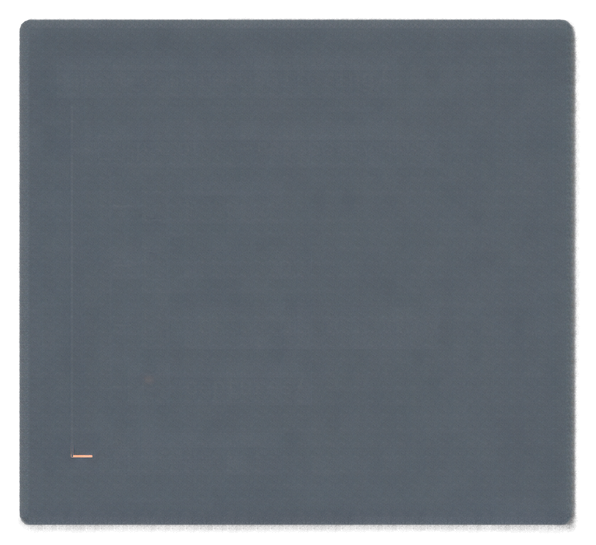








GitHub Repository
and Folder Structure
smartCamera-monitoring/
prototype-raspberry-pi5/
Repository
main.py
https://github.com/hannnejesse/smartCamera-monitoring
camera.py
What's inside
prototype-raspberry-pi5/ contains the
core code and capture storage
motionDetection.py
captures/
Project hygiene
.gitignore
.gitignore excludes image
files and Python cache

Slide 10
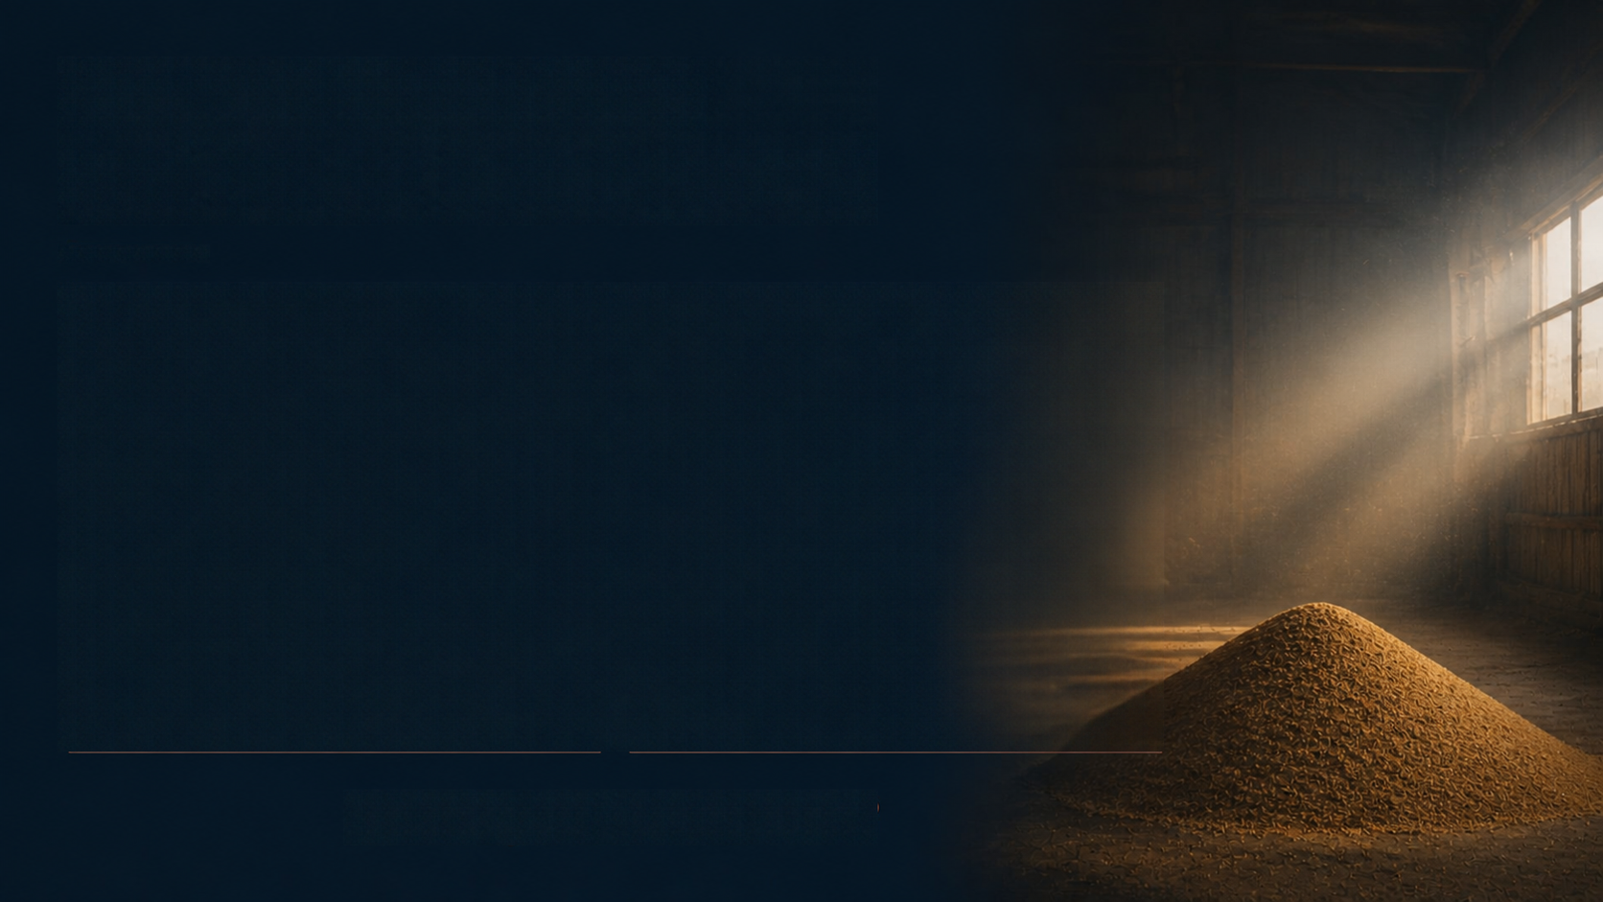
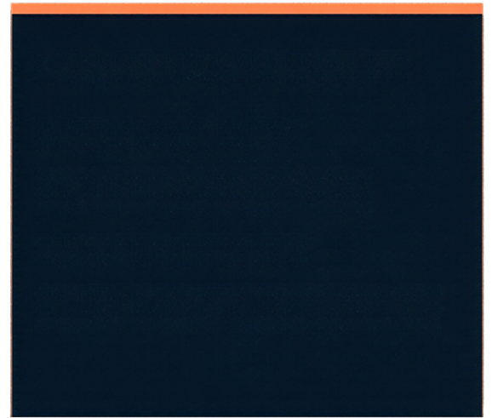
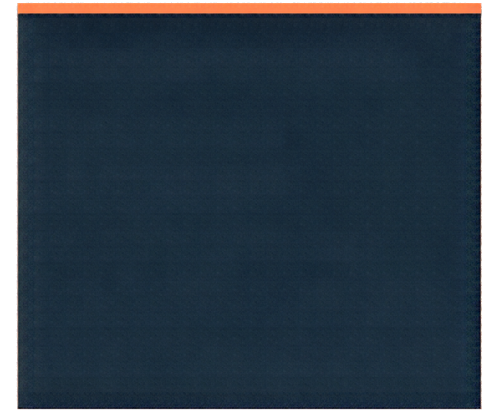
Current Limitations
and Future Development
CURRENT LIMITATIONS
FUTURE DEVELOPMENT
Simulated frames only
Integrate real camera
No physical hardware testing
Configure live capture
Thresholds need tuning
Field test in dusty environment
Dust/lens cleaning not implemented
Develop enclosure and lens cleaning
Compare with ESP32-S3 prototype

